Slide 1
Denominators Team Project Updates
Roma Bhatkoti & Joshua Davis
March 2020

Slide 2
Agenda
Notes from January VMMC Meeting with Avenir
Matt and Jeff (Imperial College) will present their work on VMMC in South Africa as a potential solution for improving the accuracy of VMMC Estimates, followed by brief discussion
Discussion on Denominators Pedes workshop, followed by discussion on planning – Output – planning document for April meeting and picking dates for the one day meeting
Notes:
UNAIDS Reference Group on Estimates, Modelling and Projections

Slide 3
January VMMC Meeting with Avenir
What was discussed
Everybody agreed that conceptually the model is sound, but there are issues with the quality of input data that feeds into the model for producing estimates. Katharine and Aisha mentioned cases where survey data for estimating baseline circumcision was not of good quality. This cause VMMC estimates to be unreliable and this gap widens further when countries get closer to saturation (as per Carlos and Katharine). Kenya paper could be a good resource to understand the reasons and sources of discrepancies and using data triangulation to estimate age-specific coverage of voluntary medical male circumcision for HIV prevention.
It was pointed out by that modeled (DMPPT2) and survey coverage estimates for the same year and group sometimes disagree profoundly at national level. The gap increases further at sub-national level.
Jeff suggested the use Small Area Estimation methodology to enhance the ability of the DMPPT2 tool to estimate district levels targets and coverage of VMMC. Jeff also mentioned the similar work they are doing in South Africa where they are trying to use HSRC survey data to do district level estimates of coverage over time that combines data from all surveys as well as program data.
It was also noted that process and timeliness of the estimates is important. It was pointed out by Jeff that not only are circumcision coverage estimates relevant for the VMMC program, there is an increasing demand from countries that their VMMC program is reflected in their incidence
Notes:
UNAIDS Reference Group on Estimates, Modelling and Projections

Slide 4
Solution for improving the accuracy of VMMC Estimates
In South Africa, Jeff’s team have tried to estimate circumcision rate over age and time based on age pattern of circumcision in successive surveys using survival analysis approach. The model was able to capture the changing age pattern and rate of circumcision over time. The model captured the difference in rates of circumcision before and after VMMC program. Before VMMC program began, the model showed that most circumcisions happened either during births or in teens (as reflective of traditional circumcisions) but post 2008, the model showed a spike in circumcisions in 10-30 age group which reflect the VMMC program.
Predicting the rate of circumcisions is the most important step in estimating VMMC coverage.
Next planned steps are
Integrating VMMC program data about number of MCs conducted into the model.
Separate components in the model to estimate the traditional and medical circumcision rates.
Using Small Area Estimation methodology to disaggregate the national numbers to sub-national level.
Notes:
UNAIDS Reference Group on Estimates, Modelling and Projections

Slide 5
Estimating the male circumcision rates in South Africa.
Matthew Thomas
Email: matthew.thomas@imperial.ac.uk

Slide 6
Data
Five surveys
SABSSM 2002, 2008, 2012, 2017
DHS 2016
Variables extracted
Demographics: Age, residence, population group, language spoken at home
Circumcision: Status, age at circumcision, where and who circumcised
Program data
Number of circumcisions reported

Slide 7
Modelling circumcisions
Two analyses
Circumcision prevalence
Aim – model age-specific circumcision prevalence by district over time
Logistic regression
Total, medical and traditional prevalence
Circumcision rates
Aim - model age-specific circumcision rate over time
Survival analysis
Total circumcision rate

Slide 8
Circumcision prevalence (Total)

Slide 9
Circumcision prevalence (Medical)

Slide 10
Circumcision prevalence (Traditional)

Slide 11
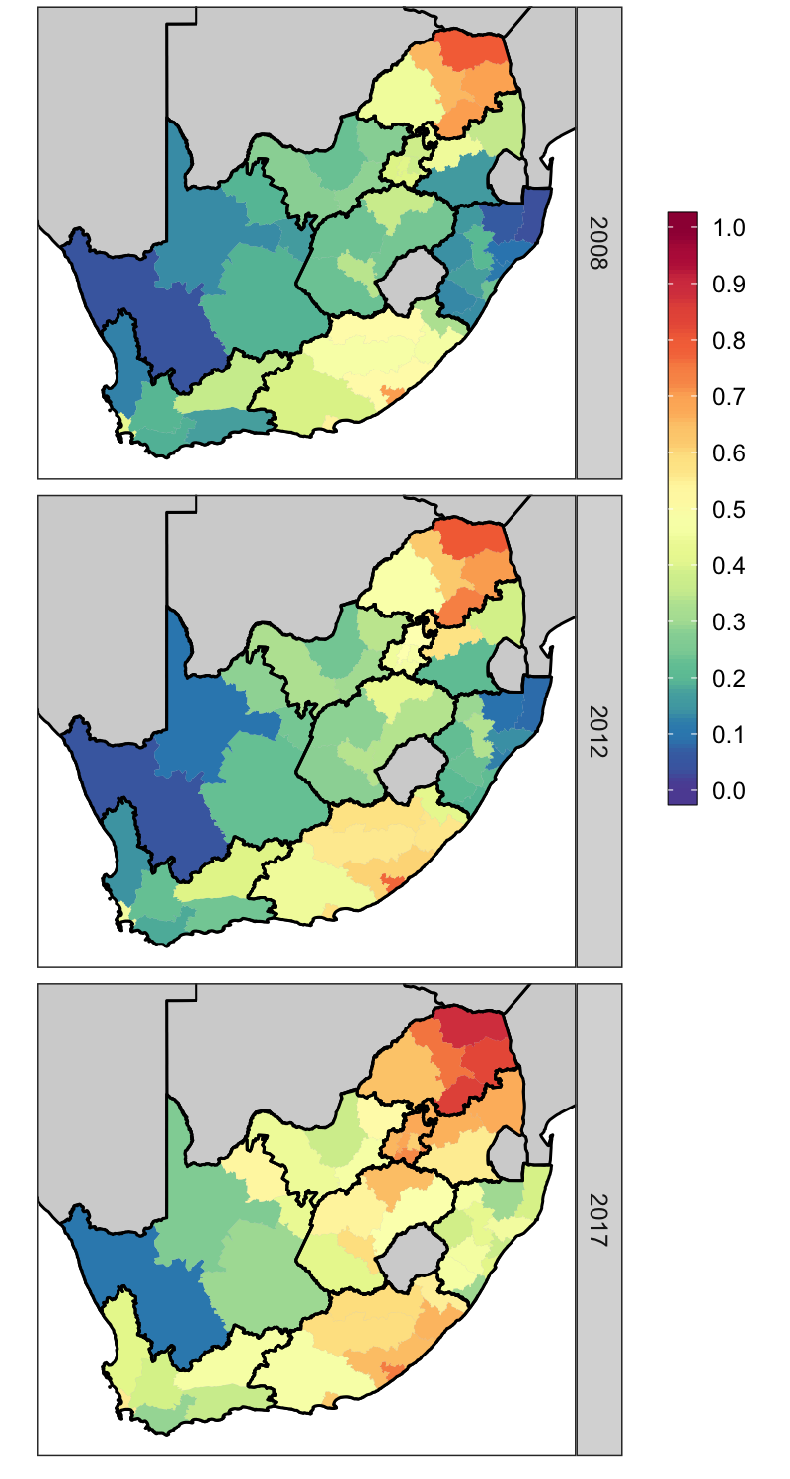
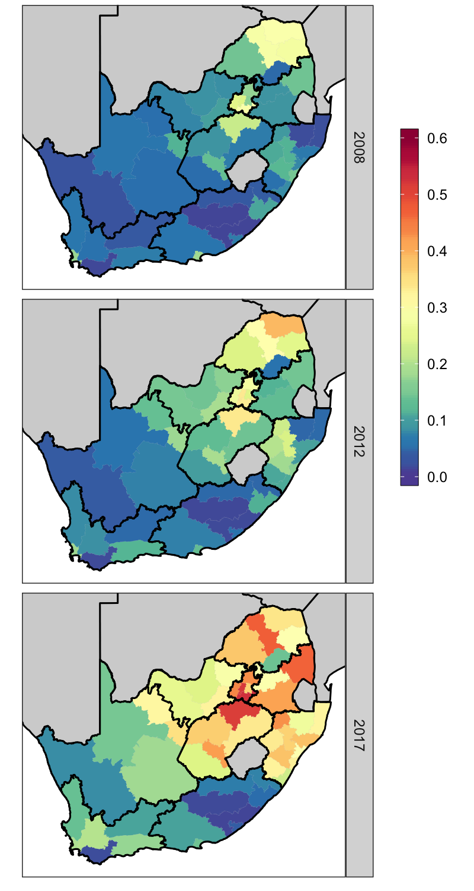
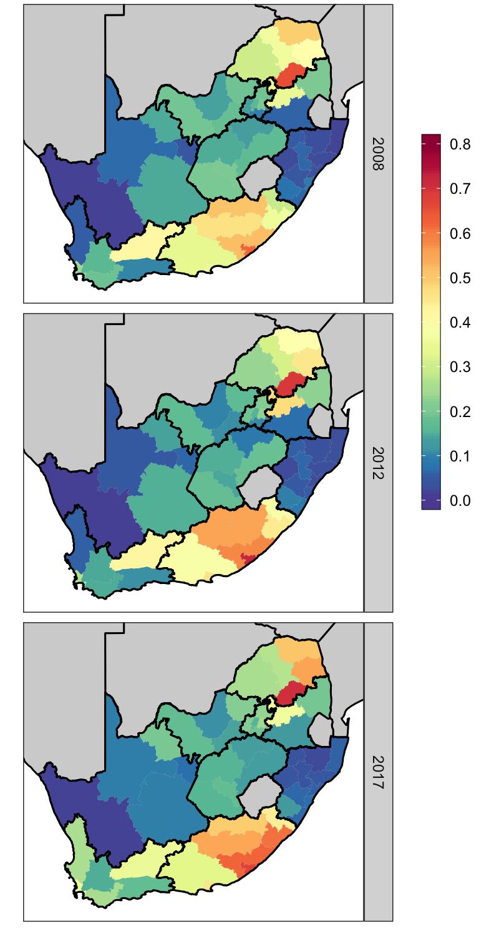
Circumcision prevalence (15-49)

Slide 12
Circumcision prevalence (15-49)

Slide 13
Prevalence: Next steps
Incorporating language or population group as a covariate.
Initial analysis has shown that language group is indicative of circumcision prevalence and how it may change over time.
Allow key groups with low circumcision coverage to be identified.

Slide 14
Circumcision rates

Slide 15
Next steps
Integrating VMMC program data about number of MCs conducted into the model.

Slide 16
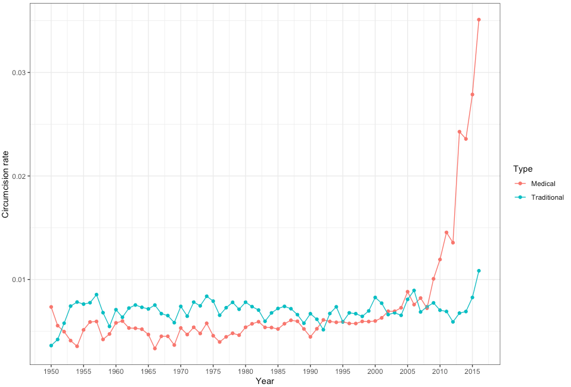
Next steps
Separate traditional and medical circumcision in the model to estimate separate rates.

Slide 17
Discussion/Questions

Slide 18
Denominators Pedes Workshop
This fall 2020, the Reference Group meeting will have a heavy focus on pediatrics. In preparation and in light of multiple discussions had with different stakeholders, the idea of holding a meeting to discuss a few key issues around CLHIV estimates seems warranted.

Slide 19
Denominators Pedes Workshop
Draft topics to discuss would be the following:
As country teams move from surveillance data for program data for number of positive pregnant women (PMTCT_STAT ANC1 only), how accurate is this data source? Does it truly capture just ANC1?
Fall 2019 Ref Group meeting – Katie offered to see about a DQA for PMTCT_STAT….what would be key considerations for this process and what to do with the output?
Aging Out
Present results from analytic analysis on aging out, including Nigeria’s EMR results – Roma and Ademola
Should additional EMR sites be used to validate?
Spectrum model has TX_CURR by one year age bands – analyze this data to assess aging in and aging out across all age bands
Census has one year age bands - analyze this data to assess aging in and aging out across all age bands
Review of Naomi outputs for CLHIV
how representative was this for the pediatric population?
how can historical PMTCT trends be included in the model?
Specifically subset of countries that represent 90% of the unmet need/new infections of kids (ex. Nigeria, South Africa….)
Follow-up to CROI, IAS and any other new evidence, should the model inputs be changed?
PHIAs not collecting data on pediatrics….now what? Ex. can we use program data on treatment to inform where peds are?

Slide 20
Mary’s feedback on Pedes Workshop Topics
Not sure about using Nigeria’s EMR data to estimate number exact age 15. but data can be pulled from WPP if needed.
A number of countries with fairly good ANC data seem to show increases in the number of women whose status was ascertained when we would expect this to be fairly flat in recent years.
I’m concerned that it is due to retesting.
It would be great if your discussion could consider DQAs that check whether retests were included in the count and prevalence data.
As mentioned above I can pull data from the spectrum files on exact age 15 numbers if that would be useful. I just sent those to George Siberry during the COP meetings because we were having side discussions on this issue and the potential LTFU actually being children aging to the next age group.
For the Naomi review, you might want some input from Jeff on challenges with those data and considerations for including pmtct in next year’s model

Slide 21
Discussion Points
Date of the workshop – End of April
Duration – 8 hours
Venue – Washington DC
Attendees Domestic/International
Topics to Cover
Plan for emergency (Travel restrictions)

Slide 22
Thanks!
Questions

